Slide 1
A Statistical Algorithm for Linguistic Steganography Detection Based on Distribution of Words
Bộ môn Khoa Học Máy Tính
Khoa Công Nghệ Thông Tin
Nguyễn Xuân Huy - 0712196
Trần Văn Tiến - 0712446

Slide 2
Nội dung
Linguistic Steganography Detection
Distribution of Words
Support Vector Machine
Testing Result

Slide 3
Linguistic Steganography Detection

Slide 4
Steganography Method
Steganography Method
NICE TEXT
TEXTTO
Markov Chain
Detect Method

Slide 5
NICETEXT
Watermark : ‘0110 …’
Style Template
Dictionary:
Ex : 101 -> midfielder take a pass.
Style | Type | Bit | Word
Footballer FbVerb FbObject | Footballer | 0 | striker
 |  | 1 | midfieldes
 | FbVerb | 0 | take
 |  | 1 | stop
 | FbObject | 0 | a pass
 |  | 1 | a shot

Slide 6
TEXTTO
Watermark : ‘abc’
Struct :
The ADJECTIVE THING VERBs ADVERB in the PLACE.I VERB ADJECTIVE THINGs near the ADJECTIVE ADJECTIVE PLACE.
Dictionary :
1..9 -> 1..9
a..z -> 10..35
A..Z -> 36..61
+,- … -> 62…
Ex : “iluvu”→ 18 21 30 31 30
→ The mad referre decide wrongly in the stadium.
TYPE | Index | Word
THING | 21 | referre
ADVERB | 31 | wrongly
VERB | 30 | decide
ADJECTIVE | 18 | mad
PLACE | 30 | stadium

Slide 7
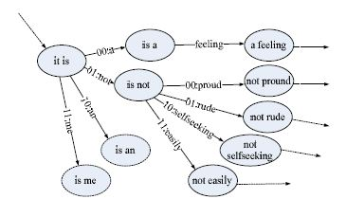
Markov Chain

Slide 8


Detect Problem 1.0
Input :
text file .
Output :
is it a stego file ?
Can be auto ?
Notes:
Te

Slide 9
Distribution of Words

Slide 10

Segment
Text segment :
Example :
Wherever you go ,whoever you will be. I will be right here waiting for you . (n=15)
S = {‘wherever’, ‘you’, ‘go’, ‘whoever’, ‘you’, ‘will’, ‘be’, ‘i’, ‘will’, ‘be’, ‘right’, ‘here’, ‘waiting’, ‘for’, ‘you’ }

Slide 11
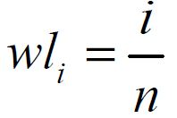
Formula 1
Word Location:
Example :
wl₀ = 0/15 = 0 (‘whatever’)
wl₁ = 1/15 = 0.067 (‘you’)
wl₂ = 2/15 = 0.133 (‘do’)
wl₄ = 4/15 = 0.266 (‘you’)
wl₁₄ = 14/15 = 0.933 (‘you’)

Slide 12
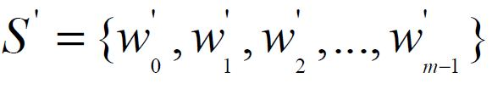

Formula 2
Represent for distinct words
Example :
S’ = {‘wherever’, ‘you’, ‘go’, ‘whoever ’, ‘will’, ‘be’, ‘i’, ‘right’, ‘here’, ‘waiting’, ‘for’ } (m=11)
WL(w’₀ ) = { 0 } (‘wherever’)
WL(w’₁ ) = {0.067, 0.266, 0.933 } (‘you’)

Slide 13
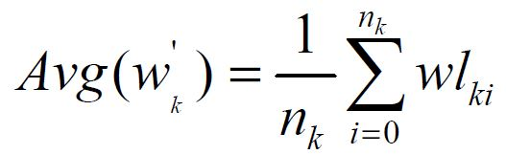
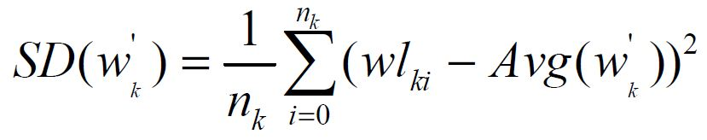
Formula 3

Slide 14
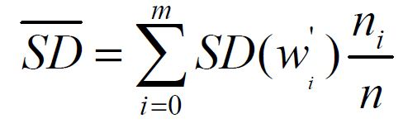
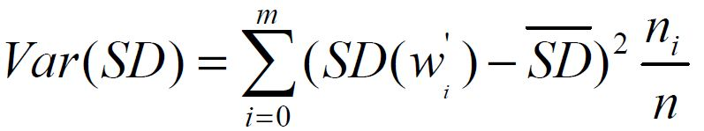
Formula 4

Slide 15

Detect Problem 1.1
Natural language text use words which concern context and subject.
Stego text generate words randomly.
Classifier
[ SD, Var(SD) ]
Notes:
Ngon6 ngữ tự nhiên có nhiều từ ngữ ổn định trong một phạm vi. Trong khi stego text từ ngữ xuất hiện theo một cách ngẫu nhiên.

Slide 16
Support Vector Machine

Slide 17
What is SVM ?
Set of related supervised learning methods.
Analyze data and recognize patterns.
Use hyperplane and kernel Function

Slide 18



How it work ?
Class : apples <> pearls.
Attribute : weight , length .
Classifier :
Classifier
choose
[ weight , length ]
choose

Slide 19
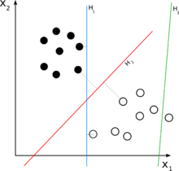
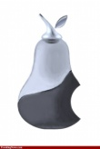
Demo
Hyperplane
H₁: Hyperplane
H₂ : Classifying
Hyperplane
H₃: not Hyperplane
length
weight

Slide 20
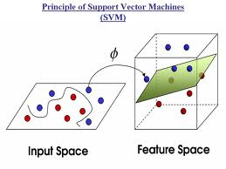
Learning Machine
Kernel Function

Slide 21
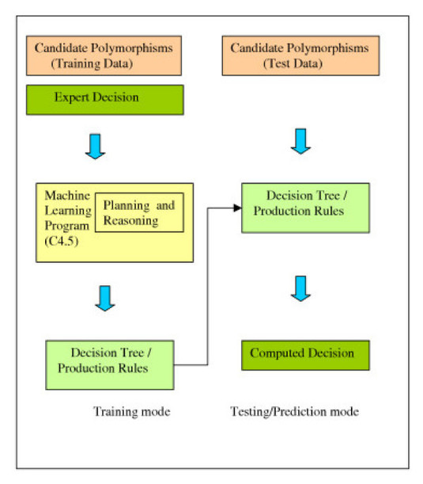
SVM Learning Machine
SVM

Slide 22
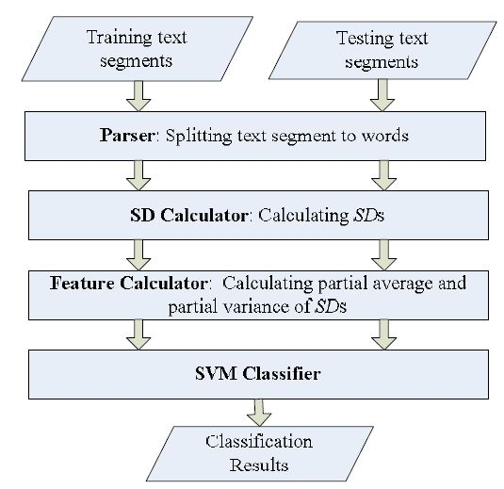
SVM Learning Machine

Slide 23
Result
Classification Result
>=85% success :
Steganography text file can be detected by SD and varSD
< 85% success :
Steganography text file can not be detected SD and varSD

Slide 24
Train & Test

Slide 25
Data Input
Trainning
109 good text segment (The Adventures of Huckleberry Finn Mural – Mark Twain)
152 bad text segment (TEXTO)
Testing
100 good text segment
100 bad text segment

Slide 26
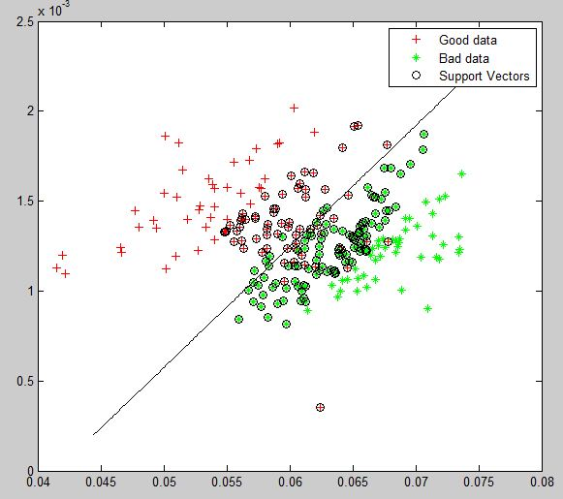
SVM Classifier

Slide 27
Result Output for 5KB-sized Segment
Type | Success | Fail | Accuracy
Good data | 88 | 12 | 88%
Bad data | 95 | 5 | 95%
All | 183 | 17 | 91.5%

Slide 28
Summary
SD and varSD of natural text lower than stego text
Stego Text File can be detect by SD and varSD with accuracy >=85% .
TEXTTO’s on low invisibility.

Slide 29
Demo

